Slide 1

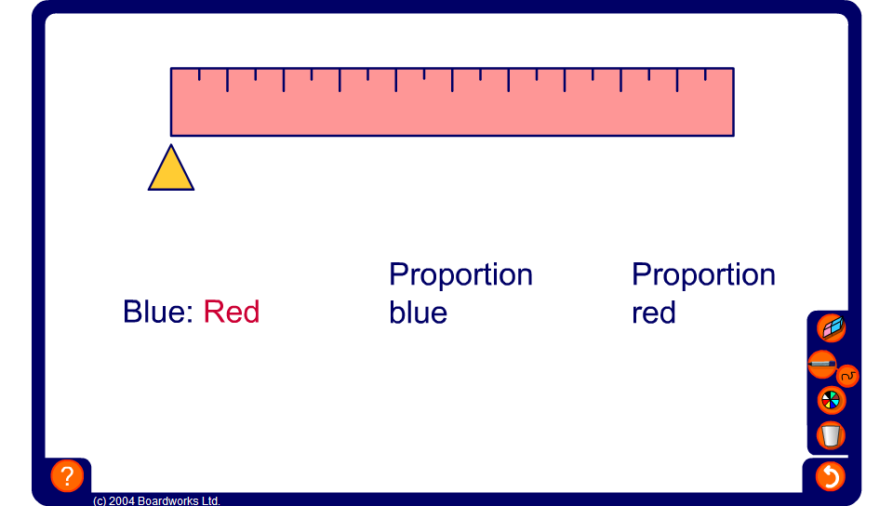


Ratios and proportions on a metre rule
Notes:
Use this activity to reinforce the difference between ratio and proportion.
Ratio compares the sizes of parts to each other and proportion compares the size of a part to the size of the whole.
Work towards the generalization that if we have the ratio a:b, the corresponding proportions will be a/(a + b) and b/(a + b).

Slide 2
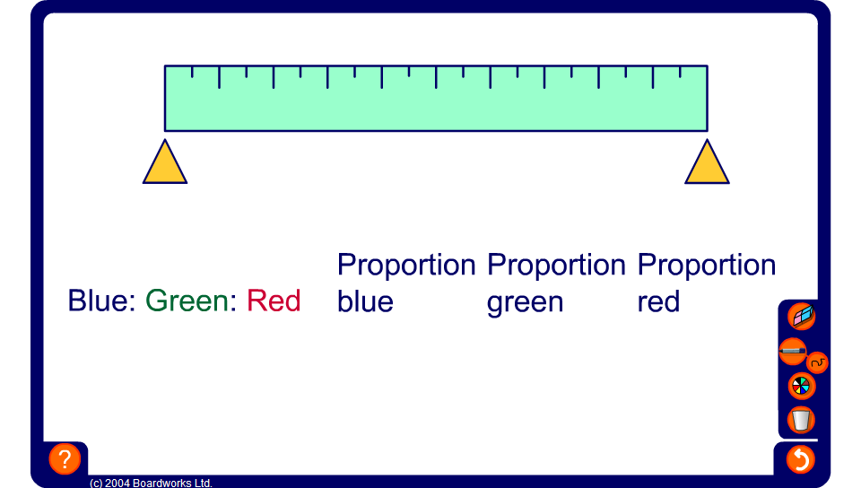
Ratios and proportions on a metre rule
Notes:
Use this activity to reinforce the difference between ratio and proportion.
Ratio compares the sizes of parts to each other and proportion compares the size of a part to the size of the whole.
Work towards the generalization that if we have the ratio a:b:c, the corresponding proportions will be a/(a + b + c), b/(a + b + c) and c/(a + b + c).

